Slide 1
Bonds
Helena Pinto

Slide 2
Debt
Debt is something that has to be repaid
Debtholders (lenders) generally expect:
Interest
Capital re-payments

Slide 3
Bond Characteristics
Bond is a type of long term debt security that obligates the issuer to make specific payments to the holder.
When companies/governments issue bonds they promise to do a series of specific payments (coupon) and to repay the debt (face value/ par value/ maturity value/ nominal value) at the maturity date.

Slide 4
Bond Terms and Characteristics
Issuer and Bondholder
Nominal Value: repayment value done by the issuer at the maturity date (5-30 years). In the UK bonds are typically issued with par values of £100; £1,000 or £10,000
Coupon: the interest (normally semi-annual) paid to the bondholder.
Coupon rate: the interest rate used to determine the coupon.
Many bonds are listed on the stock exchanges
Bonds can be sold and thus investors can get their money back before maturity

Slide 5
Trust Deeds
Trust deed (bond indenture), trustees ensure compliance with the contract
Affirmative covenants
Requirement to disclose financial statements
Requirement to do regular payment
Negative (restrictive) covenants
Limits on further debt issuance
Dividend level
Limits on the disposal of assets
Financial ratios
Trust deeds should reduce the risk of default

Slide 6

Different Types of Bonds
Conventional bonds- Vanilla; straight
GILTS – gilt-edged (of the highest quality) stocks.
Zero-Coupon
Floating Rate
Callable
Irredeemable/perpetual/Consols
Mini-Bonds (cannot be traded)- retail bonds (traded)
Green Bonds

Slide 7
Pricing Three different types of bonds
Consols/Perpetuities
Zero coupon Bonds
Coupon Bonds

Slide 8
Consol
Imagine that you bought today a bond with £100 nominal value and a 6.5% annual coupon. This bond is a perpetuity. What is the price?
£6.5
£6.5
£6.5
year
0
1
2
….
-Price
Price=PV

Slide 9
Consols Pricing
£6.5
£6.5
£6.5
year
0
1
2
….
-Price
The 6.5% bond will not be the only consol bond in the market with the same level of risk. Imagine that identical bonds were offering a return of 3.9%- YIELD TO MATURITY.
3.9% is the minimum return demanded on this bond
We know how to value perpetuities

Slide 10
Zero Coupon Bonds (Discount)
Bond that pays no coupon and returns the nominal value at Maturity
Imagine that you bought today a Bond with £100 nominal value and no coupons. This bond matures 3 years from now and its yield to maturity is 2% (P.a.). If you keep it until maturity your cash flows will be
£100
year
0
1
2
3
-Price

Slide 11

The Coupon Bond Price
Imagine that you bought today a bond with £100 nominal value and a 6.5% annual coupon. This bond matures 3 years from now and its yield to maturity is 3.9%. If you keep it until maturity your cash flows will be
£6.5
£6.5
£100+6.5
year
0
1
2
3
-Price
number of coupons
coupon

Slide 12
The value of the bond is
£6.5
£6.5
£100+6.5
year
0
1
2
3
-Price

Slide 13
Example
Suppose that you are considering buying a 3-year GILT with a coupon rate of 10% (coupon is paid annually) and a nominal value of £100. Your investment advisor quotes £113.62
£10
£10
£100+£10
year
0
1
2
3
£-113.62

Slide 14
Current Yield/Interest yield
Current yield is the annual coupon payments divided by the bond price.
Total return depends on both interest income and capital gains/losses.
In our example although the bond is bought today for £113.62 a loss is guaranteed 3 years from now (assuming that we will keep it to maturity). The total return should be lower than 8.8%.
£10
£10
£100+£10
year
0
1
2
3
£-113.62

Slide 15
Holding period return over 1 period
Holding Period Return (also called rate of return) is the total income per period per pound invested (for 1 period of time)
Suppose you buy the 10% Bond (annual coupon) today for £113.62 and sell it next year for £110.

Slide 17
The Coupon Bond Price
Imagine that you bought today a Bond with £100 nominal value and a 6.5% annual coupon. This bond matures 3 years from now and its yield to maturity is 3.9%. If you keep it until maturity your cash flows will be
£6.5
£6.5
£106.5
year
0
1
2
3
-Price

Slide 18
Estimate now the bond price if
£6.5
£6.5
£106.5
year
0
1
2
3
Ytm=6.5%=coupon rate
Ytm=7.5%>coupon rate
-Price

Slide 19
Bonds with yields lower than coupons have a price larger than nominal value
Above Par; At Premium
Bonds with yields higher than coupons have a price smaller than nominal value
Below Par; At discount
As the yield increases the price of the bond decreases

Slide 20
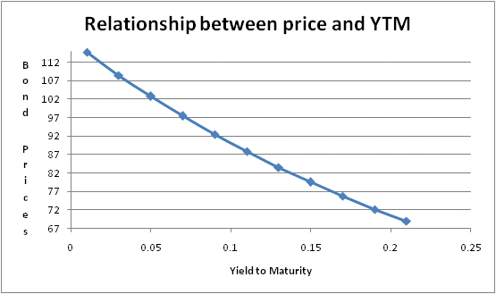
Relationship between YTM and prices
The relation between bond prices and YTM is inverse: as the YTM increases the bond prices decrease.
Notice that the relationship is not linear it is convex

Slide 21
Yield to Maturity
Market rate of equivalent bonds with the same level of risk
The yield to maturity represents the total (annual) expected return (coupon, reinvestment of coupons and capital gain/losses) if the bond is kept until maturity.
The yield to maturity is the discount rate at which the present value of the future payments equals the price of the bond.

Slide 22
Yield
Suppose that you are considering buying a 3-year GILT with a coupon rate of 10% (coupon is paid annually) and a nominal value of £100. Your investment advisor quotes £113.62. What is the ytm?
£10
£10
£110
year
0
1
2
3
£-113.62

Slide 23
Yield to Maturity
£10
£10
£110
year
0
1
2
3
£-113.62
Yield to maturity is the rate for which the present value of the bond’s payments equals the price.
Trial an error

Slide 24
Simple interpolation

Slide 25
Yields…
Current Yield- return in terms of income/interest
Holding period return- total return over the period you are holding
Yield to Maturity- the total expected return if you hold the bond until maturity

Slide 26
Are bonds safe investments?

Slide 27
Bond Ratings
What do Bond Ratings Depend Upon?
Main Factors
Probability of Default
Protection Provided by Loan Contract if Default Occurs

Slide 28
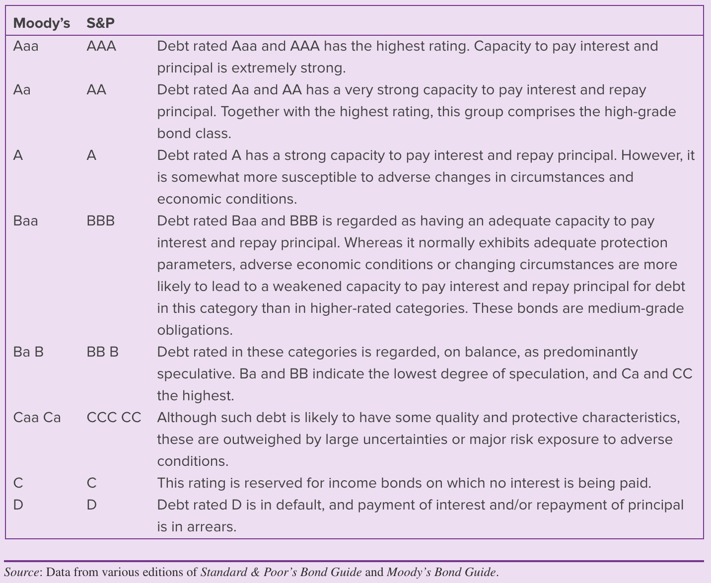
Bond Ratings
Credit Ratings: Standard & Poors and Moody’s
Investment grade are bonds rated Baa or above by Moody’s or BBB and above by Standard and Poor’s.
Junk bond is a bond with a rating below Baa or BBB.

Slide 29
From the firm point of view: Equity vs Debt
Advantages of Debt
Equity is more expensive
Less risk of loss of control
Interest is tax deductible
Disadvantages of Debt
Obligation to pay interest
Obligation to repay equity capital
Creditors often require that the loan is secured against some asset(s) of the business

Slide 30
Appendix

Slide 31

Problem
What is the price of a 20 year 7% coupon bond (with semi-annual interest payments and a face value of £100) and a yield to maturity of 6%? Bonds pay simple interest and thus its rates are proportional (The coupon rate and yield are quoted in proportional terms and both rates are annual)
$$P_{0}=3.5\left[\frac{1}{3\%}−\frac{1}{3\%{(1+3\%)}^{40}}\right]+\frac{100}{{(1+3\%)}^{40}}=£111.557$$

Slide 32
Extra examples -Corporation Y bonds are trading at £89.92, have 20 years to maturity, £100 face value and pay a semi- annual coupon of 9 percent (annual rate) what is its yield to maturity?

